Slide 1

Lab 4 Keypad
Dr. Jingtong Hu
Department of Electrical and Computer Engineering
Swanson School of Engineering
jthu@pitt.edu
Notes:
Instructions for editing school and department titles:
Select from menu: View > Master > Slide Master
Click on each text area you wish to edit. Text will become editable.

Slide 2
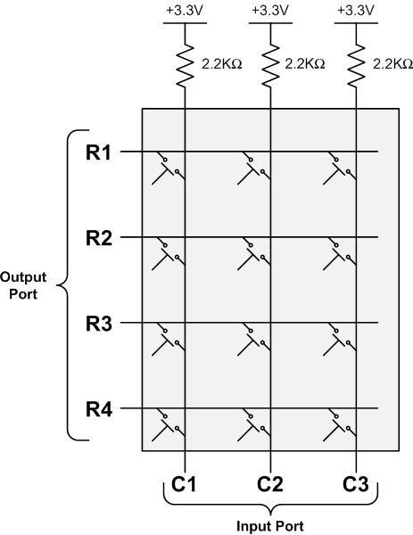
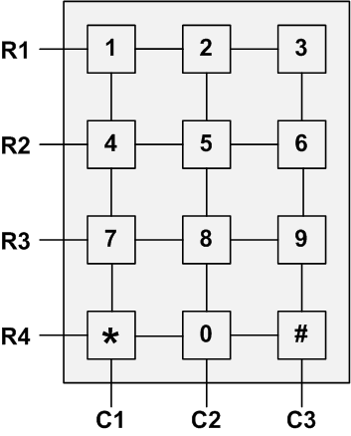
Keypad Scan

Slide 3
Keypad Scan
0
Step 1: Set Output
R1,R2,R3,R4 = 0000
Step 2: Read Input
C1,C2,C3 = 111
0
0
⟹ No key pressed
0
1
1
1

Slide 4
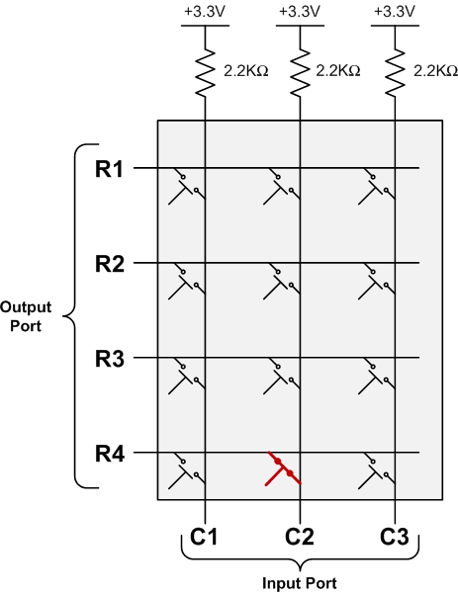
Keypad Scan
Key “0” is pressed

Slide 5
Keypad Scan
0
Step 1: Set Output
R1,R2,R3,R4 = 0000
Step 2: Read Input
C1,C2,C3 = 101
⟹ Some key in 2nd column is pressed down
0
0
0
1
0
1

Slide 6
Keypad Scan
0
Step 1: Set Output
R1,R2,R3,R4 = 0000
Step 2: Read Input
C1,C2,C3 = 101
⟹ Some key in 2nd column is pressed down
0
0
0
Which one?
1
0
1

Slide 7
Keypad Scan
Scan 1st row
0
Step 1: Set Output
R1,R2,R3,R4 = 0000
Step 2: Read Input
C1,C2,C3 = 101
Step 3a: Scan 1st row
R1,R2,R3,R4 = 0111
C1,C2,C3 = 111
⟹ No key in 1st row
is pressed down
1
1
1
1
1
1

Slide 8
Keypad Scan
Scan 2nd row
1
Step 1: Set Output
R1,R2,R3,R4 = 0000
Step 2: Read Input
C1,C2,C3 = 101
Step 3b: Scan 2nd row
R1,R2,R3,R4 = 1011
C1,C2,C3 = 111
⟹ No key in 2nd row
is pressed down
0
1
1
1
1
1

Slide 9
Keypad Scan
Scan 3rd row
1
Step 1: Set Output
R1,R2,R3,R4 = 0000
Step 2: Read Input
C1,C2,C3 = 101
Step 3c: Scan 3rd row
R1,R2,R3,R4 = 1101
C1,C2,C3 = 111
⟹ No key in 3rd row
is pressed down
1
0
1
1
1
1

Slide 10
Keypad Scan
Scan 4th row
1
Step 1: Set Output
R1,R2,R3,R4 = 0000
Step 2: Read Input
C1,C2,C3 = 101
Step 3d: Scan 4th row
R1,R2,R3,R4 = 1110
C1,C2,C3 = 101
⟹ key in 4th row
is pressed down
1
1
0
1
0
1

Slide 11
Keypad Scan
1
⟹ Key pressed is located at the second column and the fourth row.
1
1
0
1
0
1

Slide 12
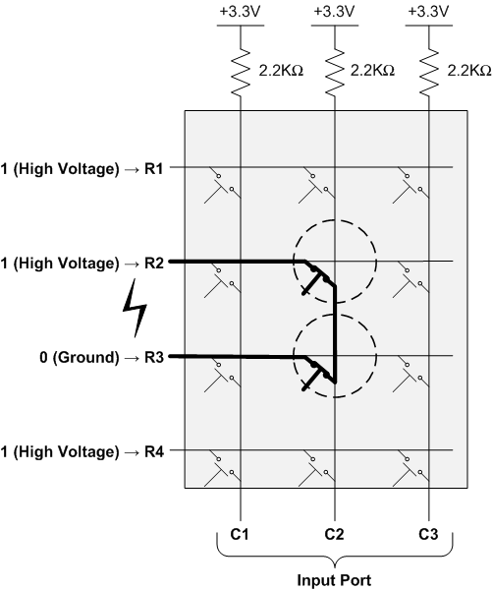
Keypad Scan

Slide 13
I/O Debouncing
Example signal when a button is pressed

